Slide 1
Today: Friday 24th november
Friday Friendly Completion

Slide 2
Today
Friday Friendly
Assembly
Spelling Mastery
QF at 9:50am
Sport
Break 1
Asia Investigations –World Records
Graduation Practice
Break 2
Health
Introduction to Puberty Quiz
Friday 24th November

Slide 3
Assembly

Slide 4
Spelling Mastery
Lesson 100
Assessment

Slide 5
Quick Fit – Run a lap of the oval. Be back at 10am.

Slide 6
Sport

Slide 7
Break 1
See you back here at 11:40am

Slide 8
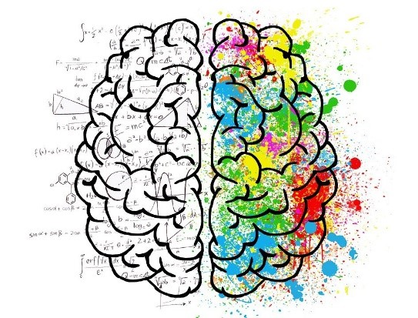
Mindfulness Take 5 minutes (11:40 to 11:45) to cool and calm
Draw, Read, MG Journal, Fold, Fiddle, Close your eyes.
Please do it on your own in silence.

Slide 9
Asia World Records
WALT: Explore Asia through world records

Slide 10
WALT
Use the Guinness World Record Books from the library.
Search Online
Think about people, places, animals, foods, money.
Explore Asia through world records

Slide 11
WALT
Find Asia’s
Tallest, Smallest, Shortest, Longest, Highest, Lowest
…
Explore Asia through world records

Slide 12
Graduation
WALT: Names, Awards and Speeches

Slide 13
WALT
Check the program.
Are you happy with your name?
Check the Awards.
Awards and Speeches

Slide 14
WALT
AWARDS in 2023:
Principal Award
Woodlands Values Award
1 x
Academic Award
1 x
Citizenship Award
2 x
Award winners receive a book of their choosing.
Awards and Speeches

Slide 15
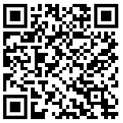
WALT
Your graduation speech.
Should be 30 to 60 seconds.
Thank the person before you on the program
Introduce yourself and how long you’ve been at Woodlands or when you started.
Include details, friends, memories, achievements and best bits.
Talk about what is next for you
Future school
Future jobs
Introduce the person next on the program.
Your graduation speech
Awards and Speeches
Every year we ask all Year 6 students to speak on the stage about their memories of primary school and their future endeavours. Use this guide to help craft your speech.
Scan the QR code to find examples.
Who do you thank?
Who do you introduce?

Slide 16
Break 2
See you back here at 2pm

Slide 17
Health
WALT: Introduce Puberty

Slide 18
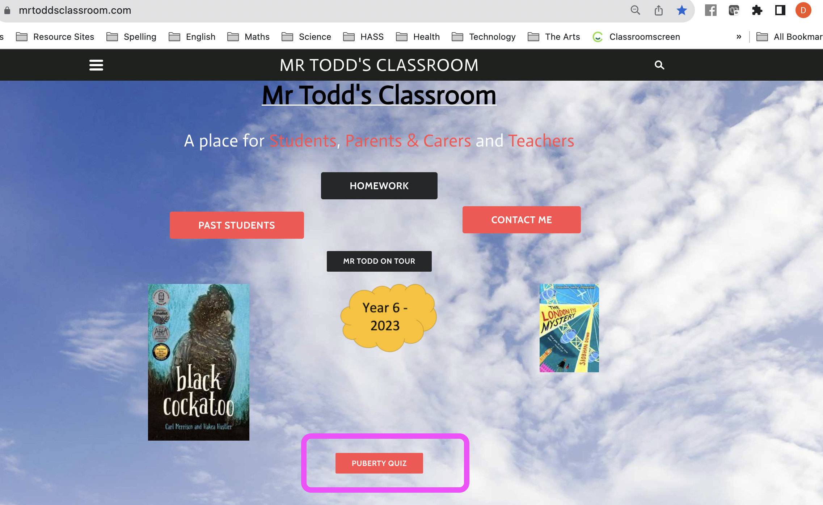
WALT
Complete the reading and quiz.
Complete the hygiene wordsearch.
Introduce Puberty

